Slide 1
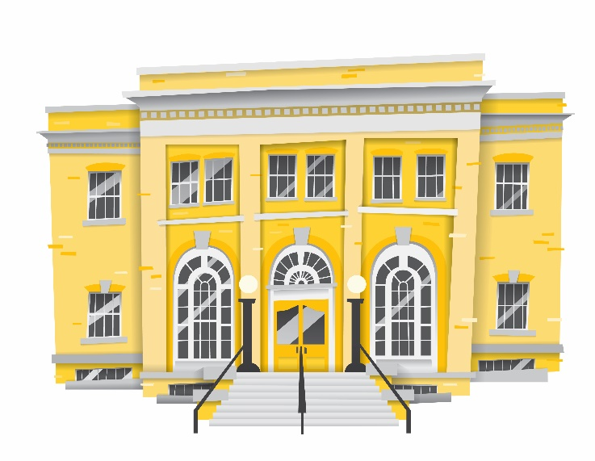

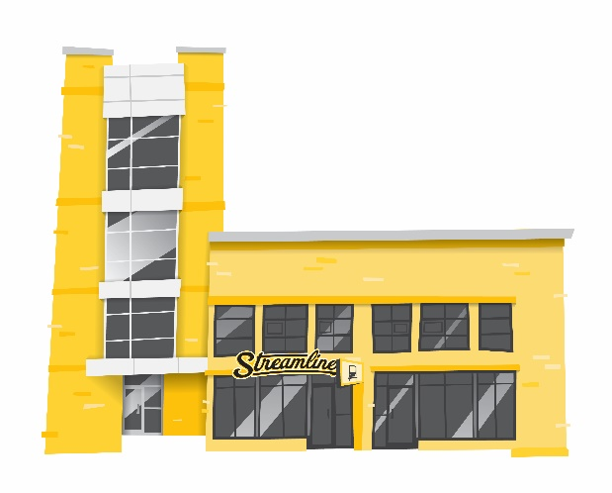

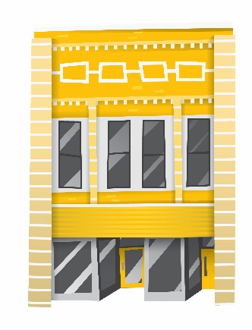





HRDC’s Transportation Programs
Streamline & Galavan

Slide 2


HRDC’s Transportation Programs
Streamline
Galavan
Operating since 2006
Fixed Route Service
Open to Public (buses are fully accessible)
Operating since 1973
Demand Response Service
Senior citizens & persons with disabilities
Notes:
Streamline Routes: Service Area
Galavan: Paratransit & Service Area

Slide 3
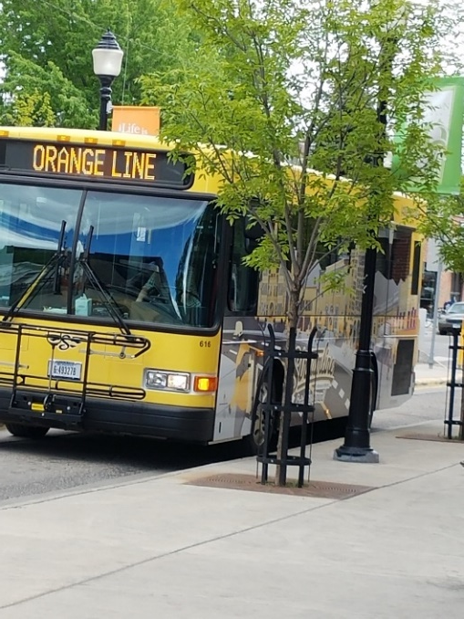
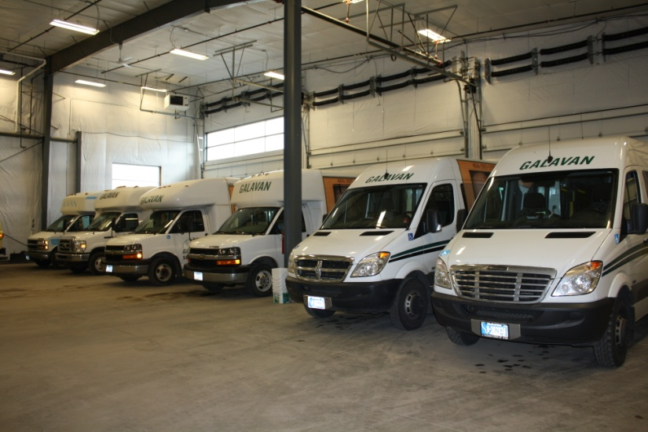
Streamline & Galavan
Public Transit
Paratransit
Fixed Routes
  3.5 Million Rides
  300,000 Rides Annually
  27,000 Hours of Service
Demand Response
  75% Medical & Employment
  30,000 Rides Annually
  200,000 Miles

Slide 4
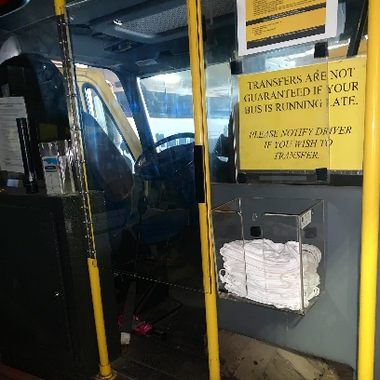
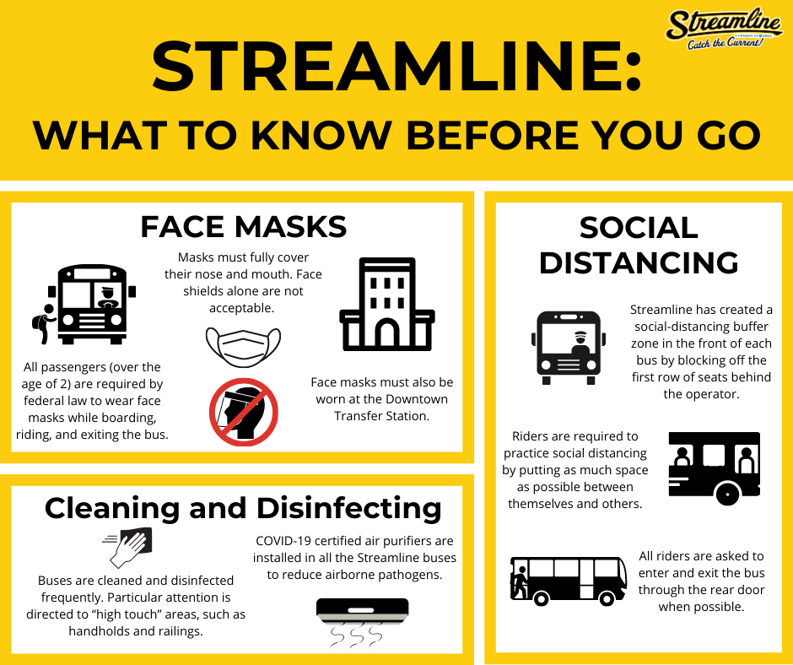
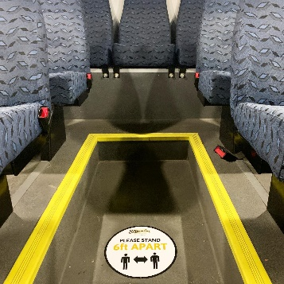
Streamline & Galavan
COVID-19 Protocols & Response
Protocols (CDC, OSHA, FTA Guidance)
  Frequent Cleaning & Disinfecting “High Touch” Areas
  Social Distancing / Rear Door Entry
  Air Purifiers / Driver Barriers
  Requiring Face Masks (Federal Law)
  Discouraging Riding when Sick
Notes:
Essential Service & Protocols in place early – Operated through the pandemic
No outbreaks related to public transportation - Globally

Slide 5
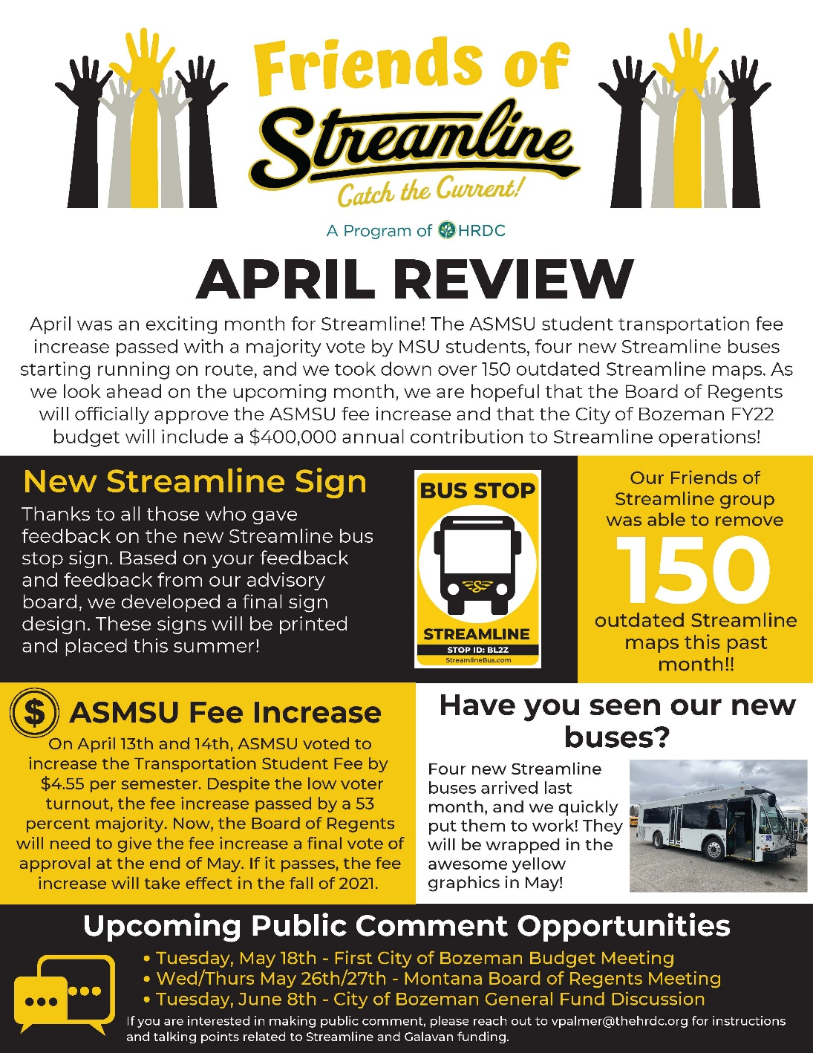

Slide 6
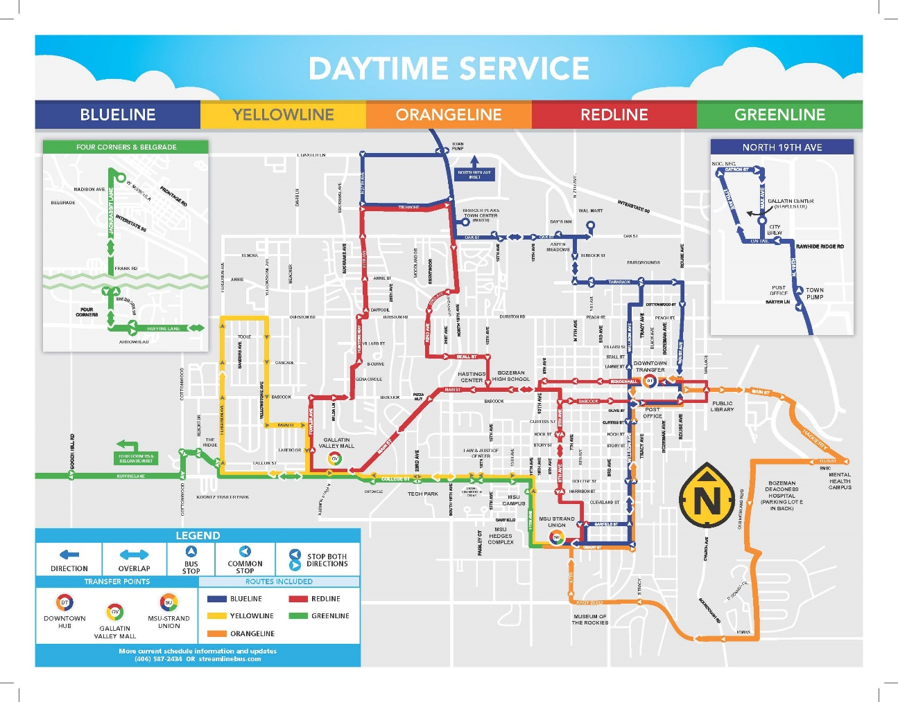

Slide 7


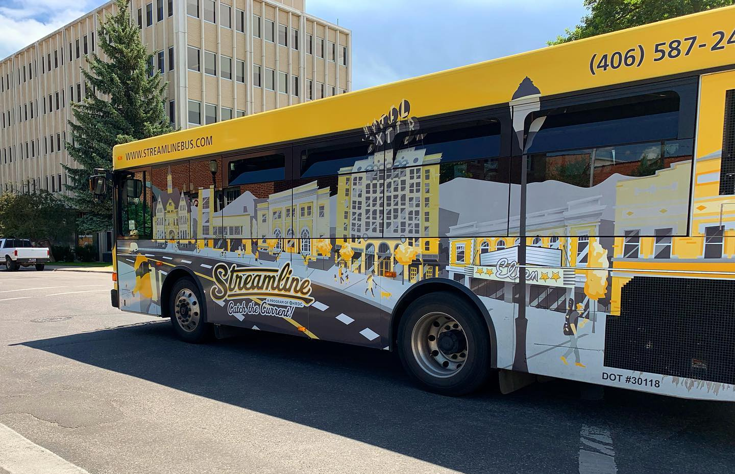
Transit Development Plan
Notes:
Existing Conditions Report (Productivity & Quality)
Survey
Preliminary Service Recommendations (Bi-directional,
Public Comment (some modifications)
Final Report issued January 2021 > Short-Term Plan starts August 2021, Long-Term Plan with sustainable increased funding

Slide 8
Service Design Principles
Provide bi-directional, to the greatest extent possible, service along streamlined alignments. This was done to shorten customer travel times and make the system easier to understand.
Focus service where density and urban form is most supportive of transit use
Retain service to all main destinations and heaviest used stops
Provide two-way service to major destinations
Provide more uniformity of service throughout the week

Slide 9
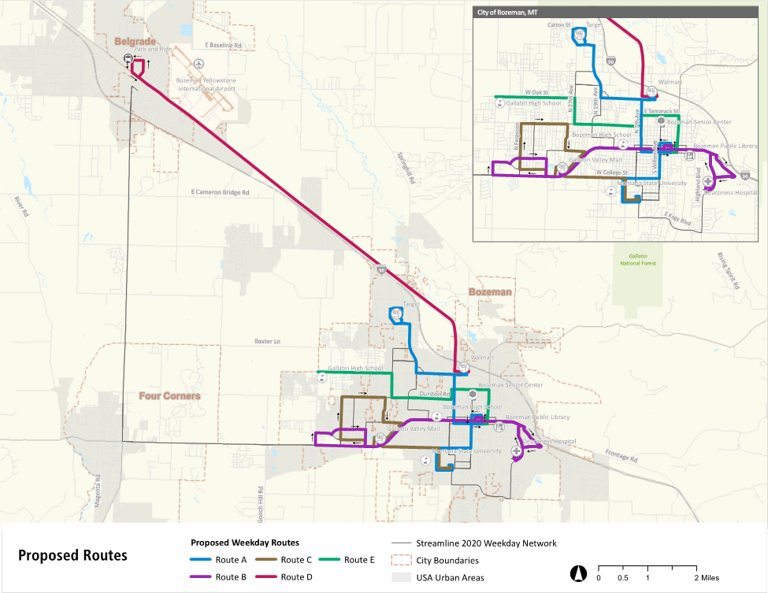

Slide 10
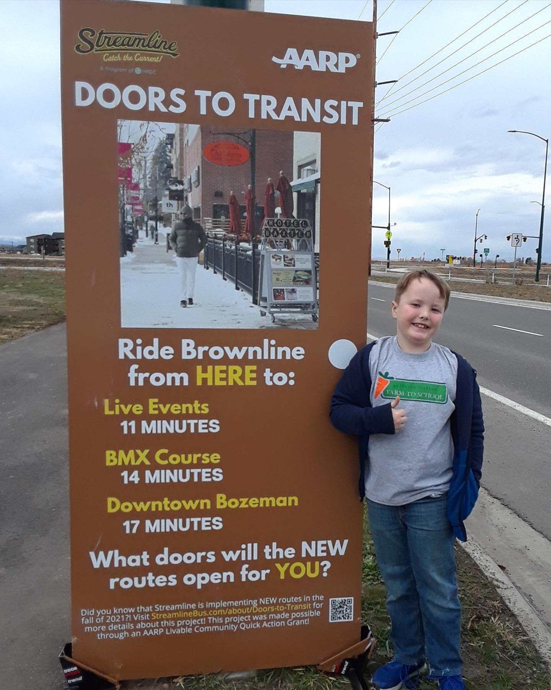
Doors to Transit Outreach Project

Slide 11
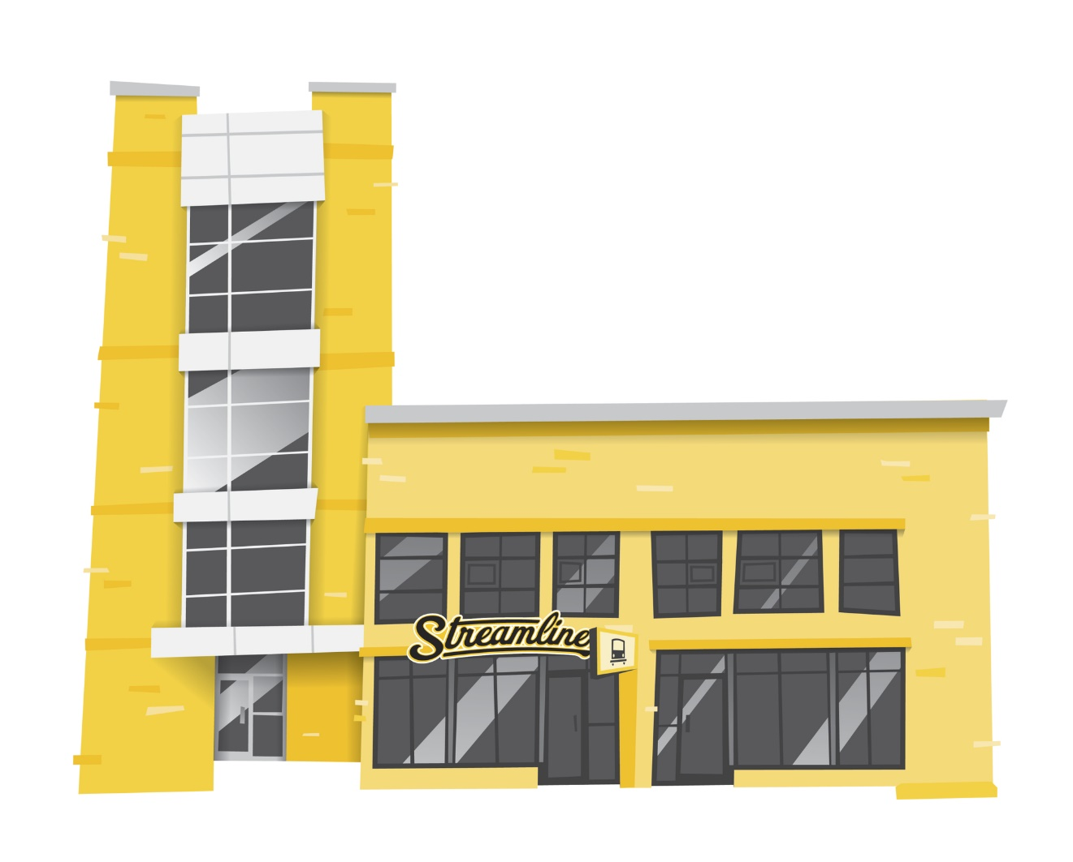


Launch Date 8/16/21
Notes:
Comprehensive Stop Audit > Inventory of new stops > New Bus Stop Signs (Wayfinding)
Design of New Brochures: Schedules & Maps (Easier to understand)

Slide 12
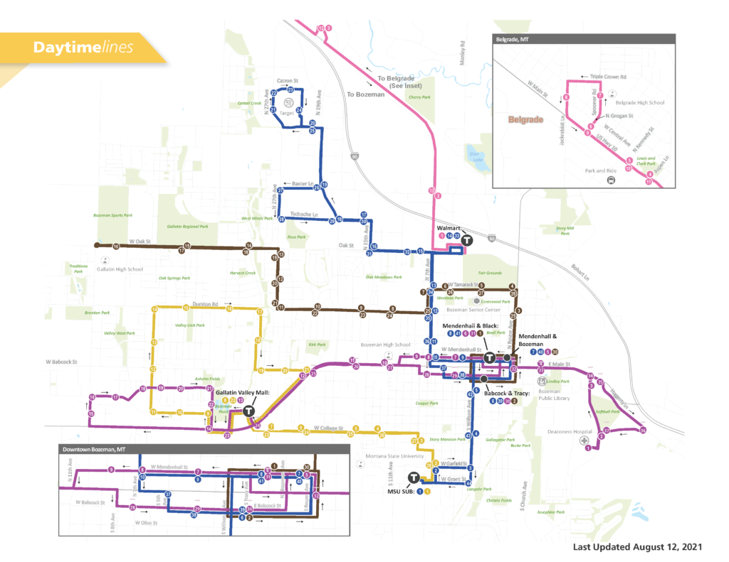
Redesigned Route Maps & Timetables

Slide 13
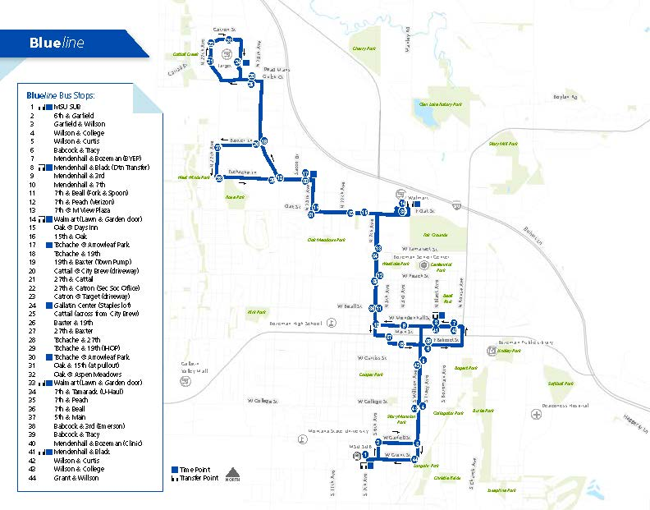

Slide 14
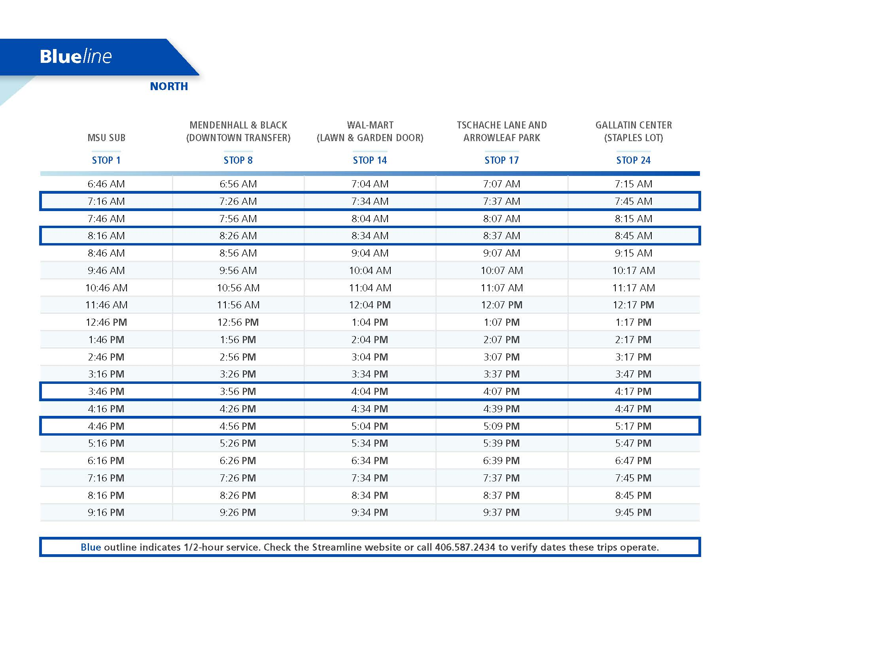

Slide 15

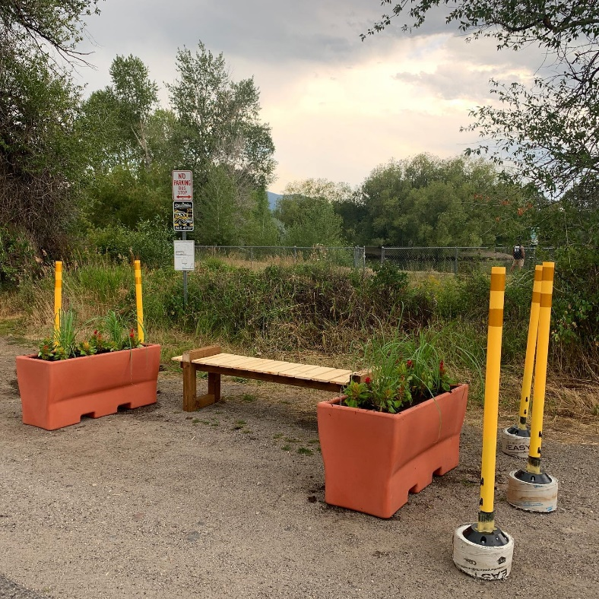

Improving Wayfinding

Slide 16
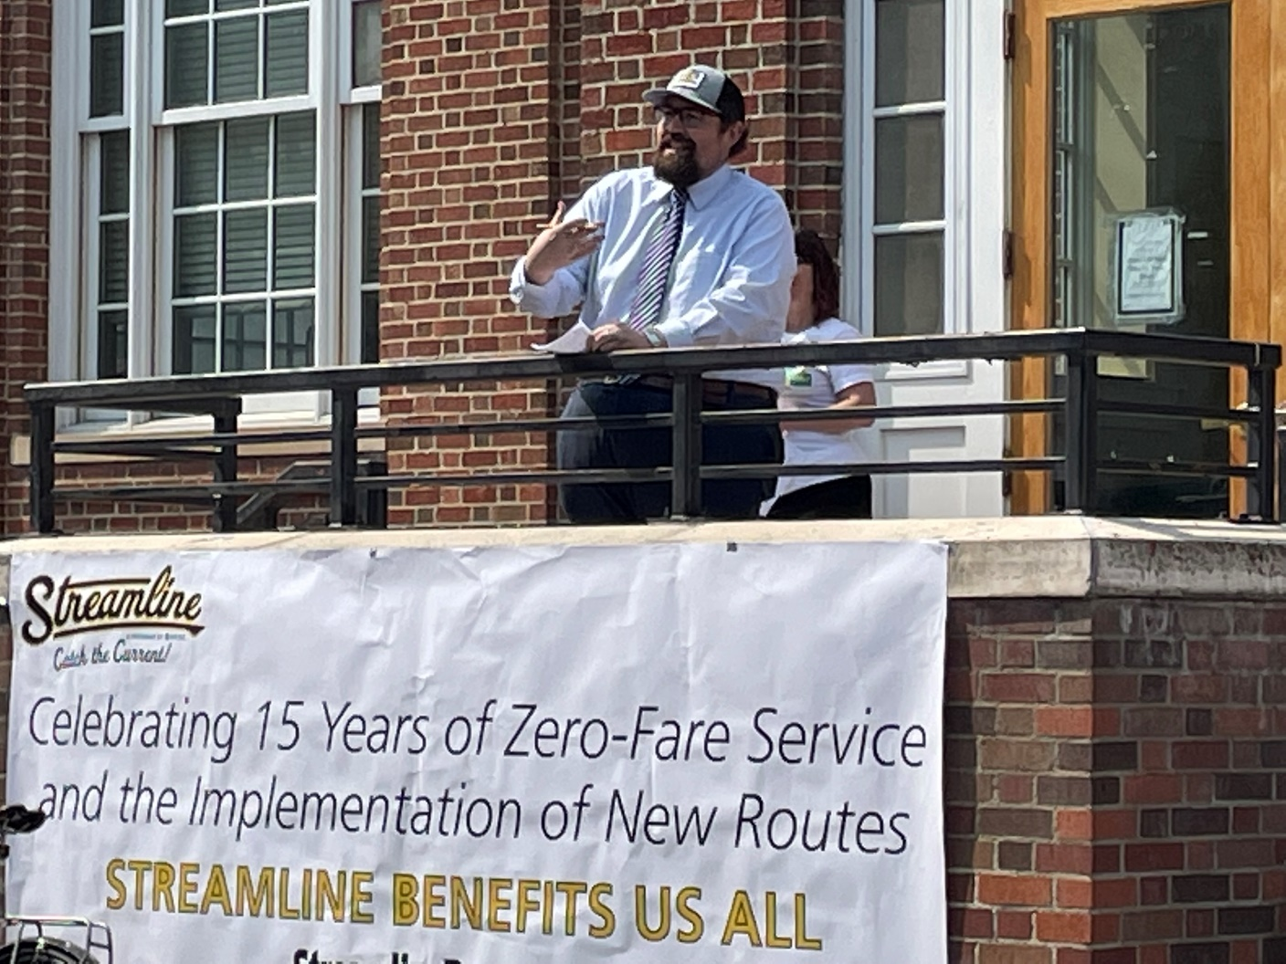
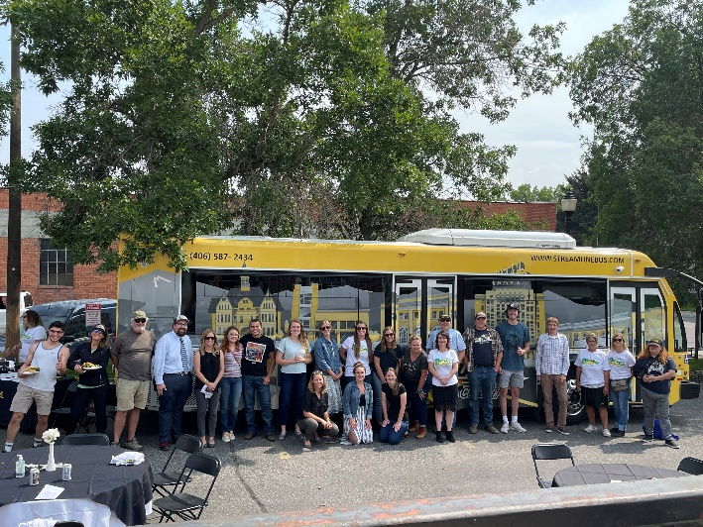
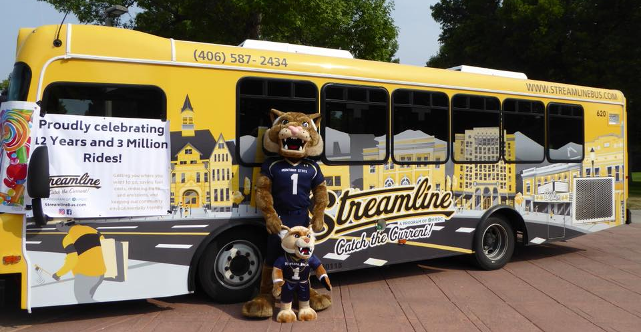
August 2021 15th Anniversary Celebration!

Slide 17
Long-Term Routes

Slide 18
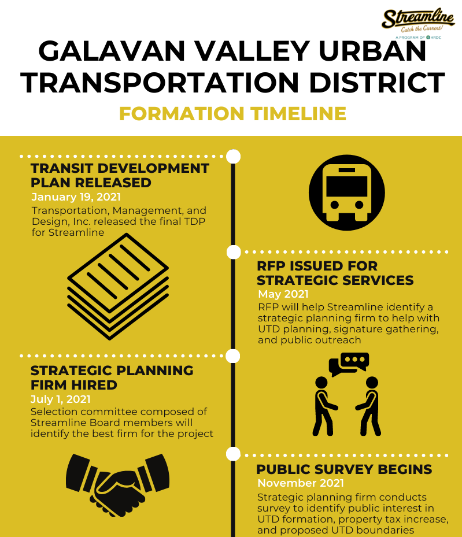
Notes:
MSU Strand Union Building (SUB) - 378
Mendenhall & Black - 108
Main & Rouse - 35
Gallatin Valley Mall - 53
Fowler & Laredo - 27
College & 23rd - 26
Tschache & 19th - 29
Walmart - 58

Slide 19
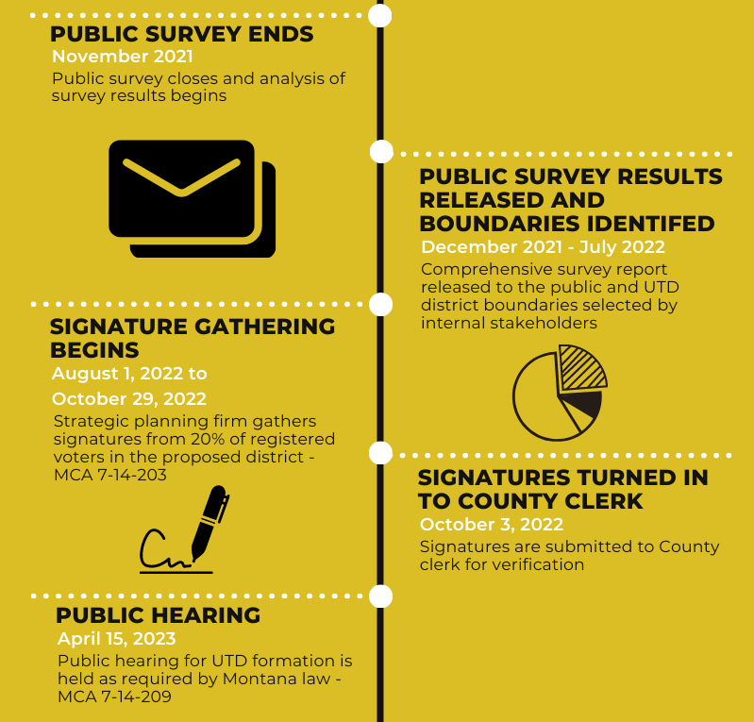
Notes:
MSU Strand Union Building (SUB) - 378
Mendenhall & Black - 108
Main & Rouse - 35
Gallatin Valley Mall - 53
Fowler & Laredo - 27
College & 23rd - 26
Tschache & 19th - 29
Walmart - 58

Slide 20
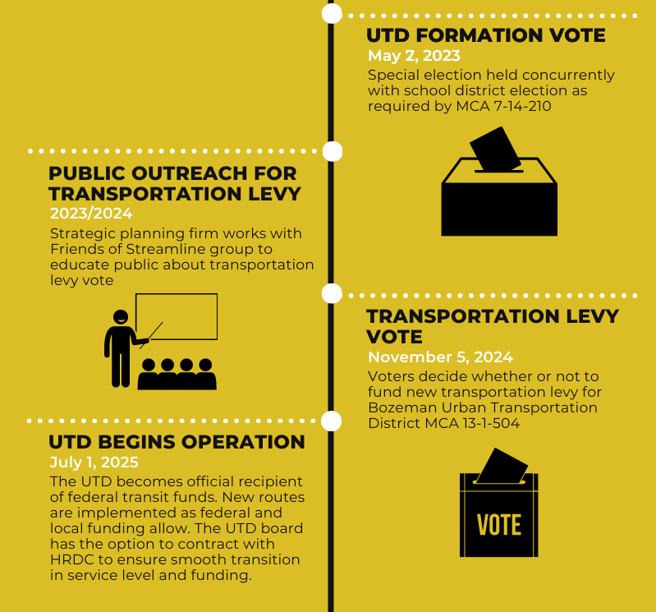
Notes:
MSU Strand Union Building (SUB) - 378
Mendenhall & Black - 108
Main & Rouse - 35
Gallatin Valley Mall - 53
Fowler & Laredo - 27
College & 23rd - 26
Tschache & 19th - 29
Walmart - 58

Slide 21
Contact Info
Sunshine Ross
sross@thehrdc.org
(406) 587-2434
Notes:
MSU Strand Union Building (SUB) - 378
Mendenhall & Black - 108
Main & Rouse - 35
Gallatin Valley Mall - 53
Fowler & Laredo - 27
College & 23rd - 26
Tschache & 19th - 29
Walmart - 58

