Slide 1
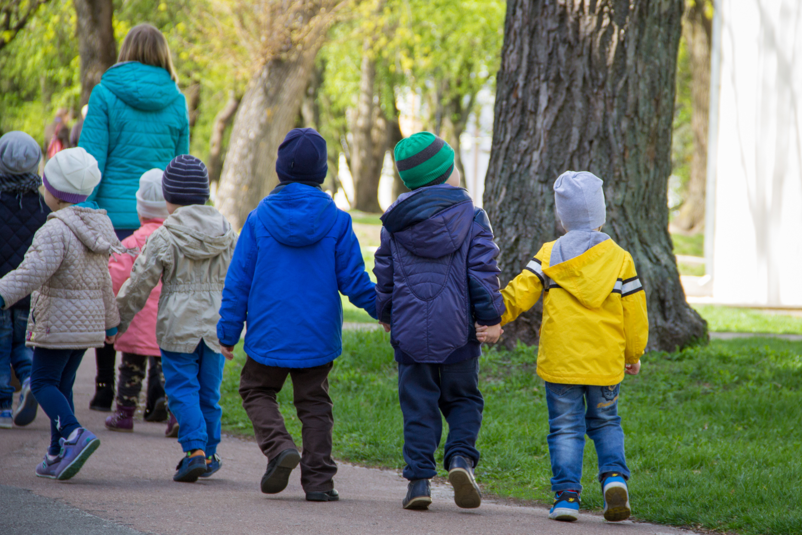
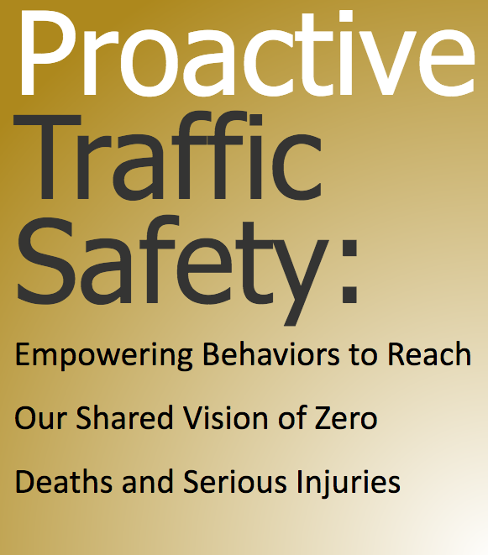
Notes:
Introduction: Thank you for joining me today to talk about proactive traffic safety.

Slide 2
^{PROACTIVE}
^{TRAFFIC SAFETY}
^{Agenda}
^{We Are in This Together}
Proactive Traffic Safety – What You Need to Know
^{Where We Go from Here}
Notes:
During our time today, we are going to talk about Proactive Traffic Safety. We will start by discussing our shared problems faced in traffic safety and introduce proactive traffic safety to address these common challenges. We are in this together.
Next, we will talk about the basics - what you need to know about proactive traffic safety. I will introduce you to proactive traffic safety by talking about what proactive traffic safety is and why growing proactive traffic safety can help us achieve our collective traffic safety goals of zero deaths on our nation’s roadways.
Finally, we’ll talk about where we go from here. Proactive traffic safety is a new opportunity to improve traffic safety, but action is needed to move this approach forward. We will talk about tools available to help you engage others about proactive traffic safety, tips, and reflection questions to get you thinking about integrating proactive traffic safety within your current efforts.

Slide 3
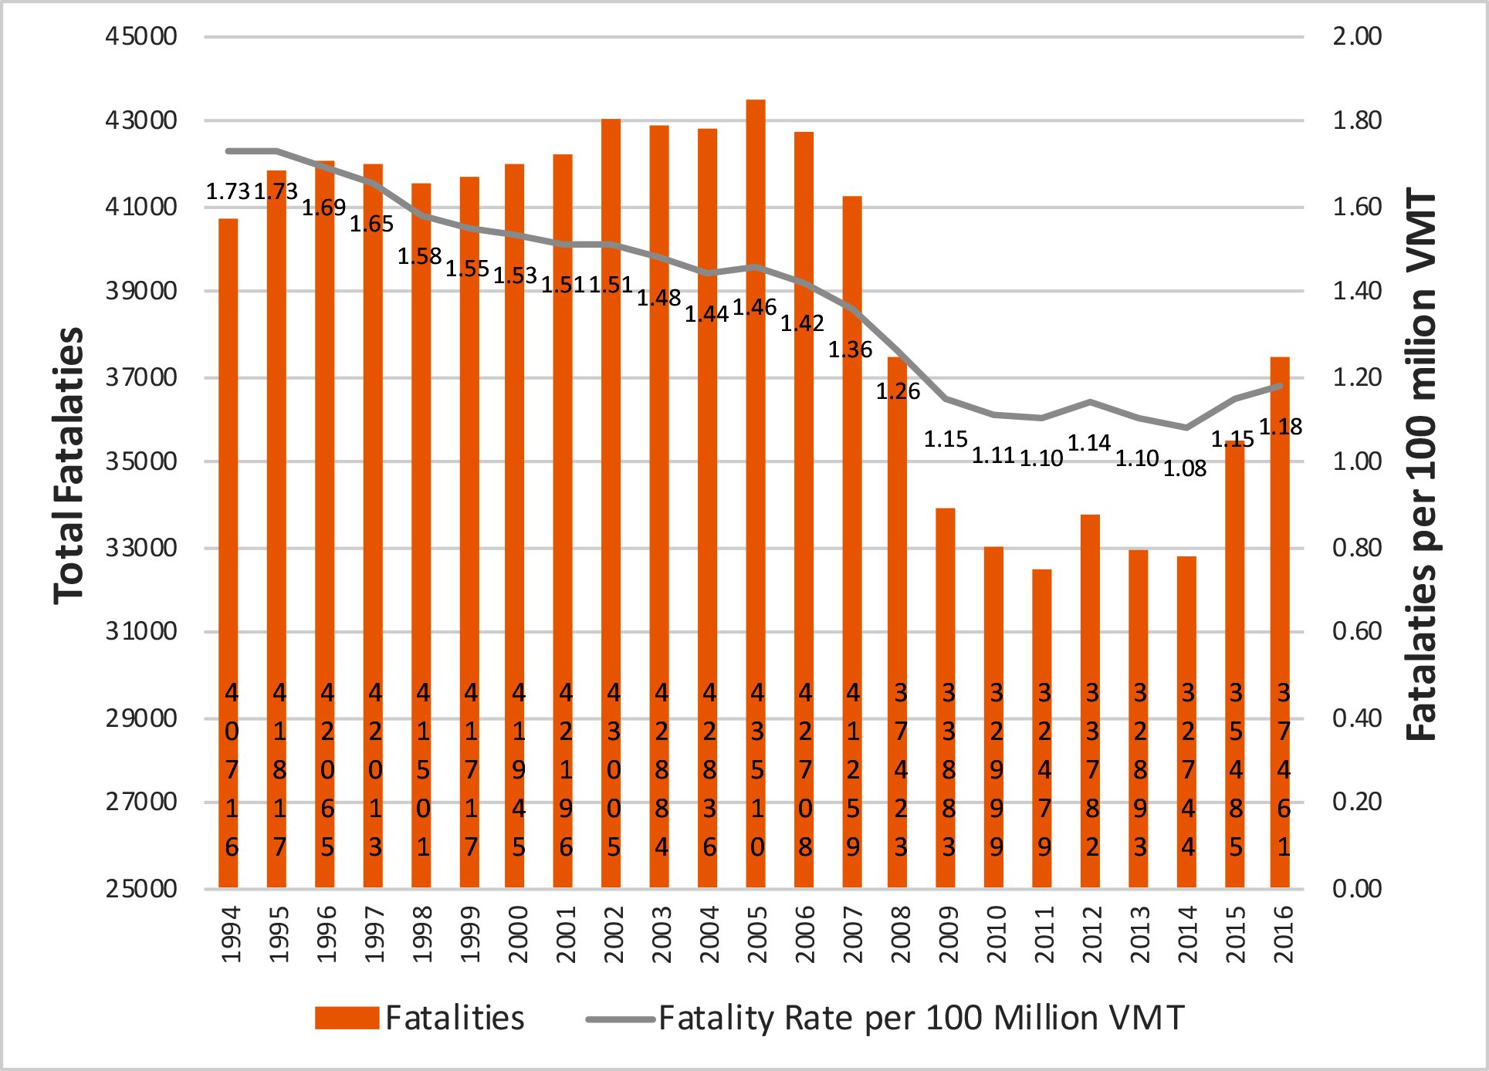
^{We Are in This Together}
The only acceptable traffic safety goal is to reduce fatalities and serious injuries to zero.
National Highway Traffic Safety Administration (NHTSA). Fatal Analysis Reporting System (FARS). Washington, DC: US Department of Transportation. 2017. https://cdan.nhtsa.gov/STSI.htm
Notes:
In 2017, 37,133 people died in motor vehicle crashes in the United States.
The people who lost their lives represent someone’s parent, sibling, coworker, spouse, friend, or child. The loss of even one person on our roadways is unacceptable.
The only acceptable traffic safety goal is to reduce fatalities and serious injuries to zero. While significant improvements in traffic safety have been made using strategies like engineering, education, and enforcement, our shared vision of zero deaths on our nation’s roadways is not fully realized. There is more work to be done to improve traffic safety.

Slide 4
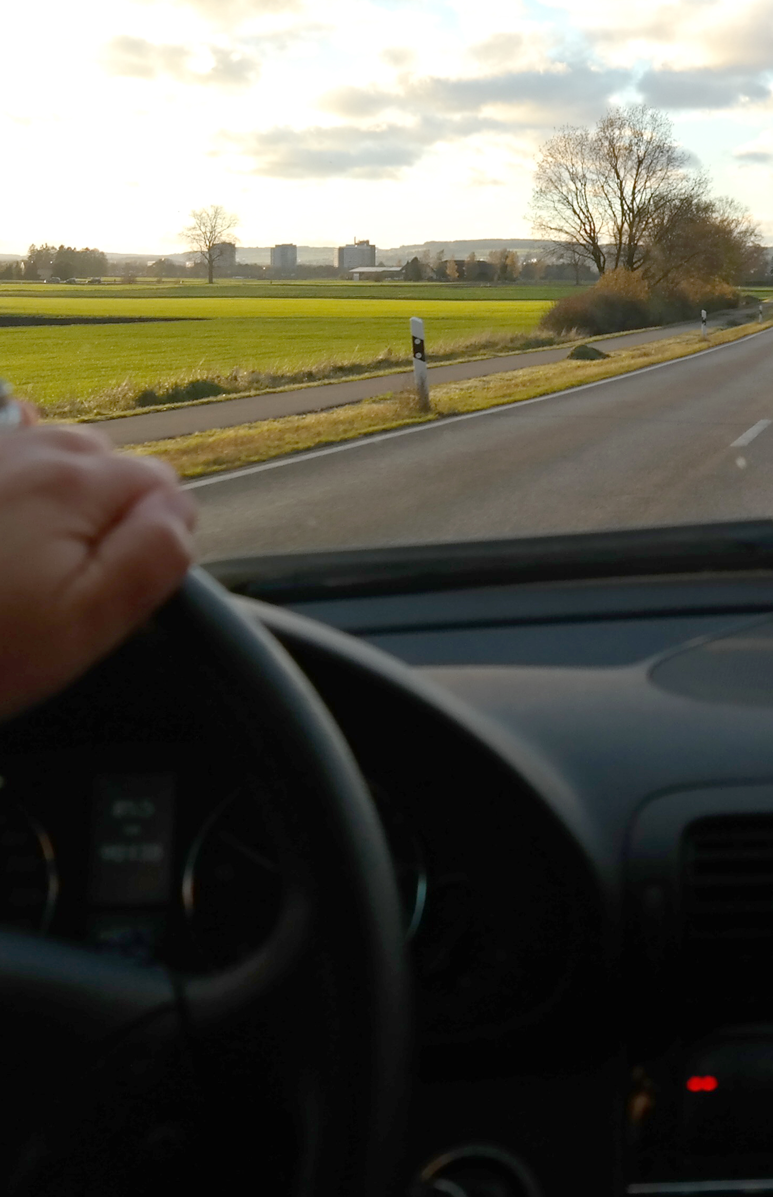
^{We Are in This Together}
Driver behavior is a significant factor contributing to motor vehicle crashes.1
To improve traffic safety, we must focus on strategies that influence risky driver behaviors.
Risky driver behaviors include deliberate behaviors like
    ^{speeding,}
    ^{texting while driving,}
    ^{impaired driving, and}
    ^{not wearing a seat belt.}
1. National Highway Traffic Safety Administration (NHTSA). Critical Reasons for Crashes Investigated in the National Motor Vehicle Crash Causation Survey. (DOT HS 812 115). Washington, DC: US Department of Transportation. 2015. https://crashstats.nhtsa.dot.gov/Api/Public/ViewPublication/812115.
Notes:
We know that a significant factor contributing to motor vehicle crashes is driver behavior. To improve traffic safety, we must focus on strategies that influence risky driver behaviors.
Risky driver behaviors include deliberate behaviors. Deliberate behaviors are behaviors that we choose to commit like: speeding, texting while driving, or not wearing a seat belt.
These deliberate risky behaviors can be changed. Motor vehicle crashes and serious injuries are preventable, and our efforts must focus on changing behavior. Specifically, we must focus on creating conditions that increase safer deliberate behaviors.

Slide 5
^{We Are in This Together}
The majority of road users already engage in safe behaviors.
  Most people (90%) wear a seat belt.1
  Most people (92%) do not drive within two hours of drinking alcohol.2
  Most people (95%) do not drive within two hours of using cannabis.2
  Most people (81%) do not speed (in excess of 10 mph over the posted speed).3
1. National Highway Traffic Safety Administration (NHTSA). Traffic Safety Facts: Seat Belt Use in 2017—Overall Results. (DOT-HS-812-465). Washington, DC: US Department of Transportation. 2018. https://crashstats.nhtsa.dot.gov/Api/Public/ViewPublication/812465.
2. Center for Behavioral Health Statistics and Quality. Results from the 2017 National Survey on Drug Use and Health: Detailed Tables. Washington, DC: Substance Abuse and Mental Health Services Administration, U.S. Department of Health and Human Services. 2018. https://www.samhsa.gov/data/sites/default/files/cbhsq-reports/NSDUHDetailedTabs2017/NSDUHDetailedTabs2017.htm#tab6-84B
3. De Leonardis, D., R. Huey, and J. Green. National Traffic Speeds Survey III: 2015. (DOT HS 812 485) (March, 2018). Washington, DC: National Highway Traffic Safety Administration. 2018.
Notes:
The good news is that the majority of road users already engage in safe behaviors:
most people (90%) wear a seat belt,
most people do not drive within two hours of drinking alcohol (8.4%) or using cannabis (4.6%), and
most people (81%) do not speed (in excess of 10 mph over the posted speed).
A positive traffic safety culture already exists. Yet, not wearing a seat belt, impaired driving, and speeding are leading risky behaviors associated with fatal and serious injury crashes – even though it is a small portion of the population that engages in these behaviors.

Slide 6
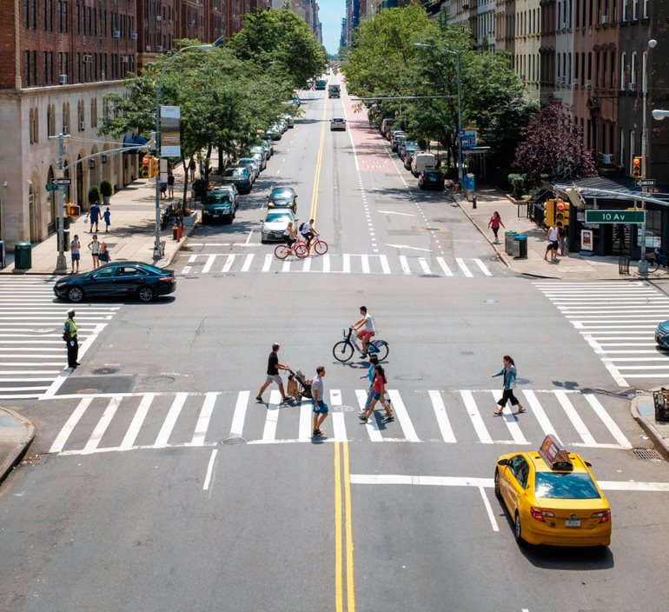
^{We Are in This Together}
^{Question}
How do we leverage the large group of people already engaging in safe road user behaviors to influence the smaller group engaging in risky road user behaviors?
^{Answer}
^{Proactive Traffic Safety}
Notes:
The question that we must ask is: “How do we leverage the large group of people already engaging in safe road user behaviors to influence the smaller group engaging in risky road user behaviors?”
One way to leverage the positive road safety culture that already exists to impact the small group of road users engaging in risky behaviors is to grow proactive traffic safety.

Slide 7
^{PROACTIVE}
TRAFFIC SAFETY – What You Need to Know
The roadway transportation system is a shared community.
Each of us is a member of the community because we depend on this shared system to connect us with people, places, goods, and services.
For this system to meet everyone’s needs and be sustained, we have an obligation to one another to act in ways that support the system.
Compliance… AND SOMETHING MORE!
Notes:
The roadway transportation system is a shared community that consists of various users including drivers, passengers, cyclists, pedestrians, and others. This system is designed, maintained, and managed by various stakeholders including departments of transportation, transportation engineers, maintenance districts, elected officials, policy makers, law enforcement officers, traffic safety leaders, Toward Zero Deaths coordinators, and others.
Each of us is a member of the roadway transportation community because we depend on this shared system to connect us with people, places, goods, and services. For this system to meet everyone’s needs and be sustained, we have an obligation to one another to act in ways that support the system.
At a basic level, individuals can meet this obligation by complying with existing laws and regulations. However, mere compliance with existing laws and regulations fails to address the myriad of situations that occur that are potentially unsafe but are not explicitly deemed unlawful. Furthermore, compliance means we accept the status quo (i.e., that over 30,000 people are killed every year) because it is the consequence of current laws.
While compliance is important, there is more. We must move beyond compliance.

Slide 8
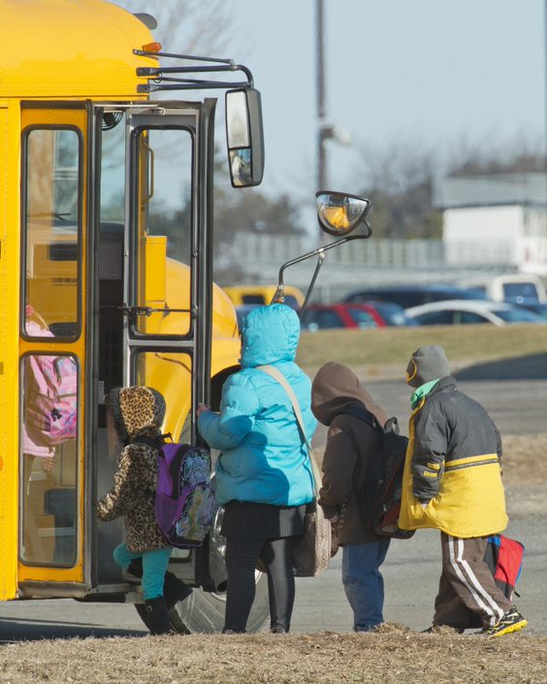
^{PROACTIVE}
TRAFFIC SAFETY – What You Need to Know
^{Commitment}
To achieve higher levels of safety, individuals need to go beyond compliance to commitment – a commitment to safety for themselves and others.
A commitment to safety means committing to avoiding risk as well as committing to taking actions to keep safe.
Notes:
To achieve higher levels of safety, individuals need to go beyond compliance to commitment – a commitment to safety for themselves and others.
Keep in mind what the word “safety” means: “the state of being safe; freedom from the occurrence or risk of injury, danger, or loss” and “the action of keeping safe.” Thus, a commitment to safety means committing to avoiding risk as well as committing to taking actions to keep safe.
Committing to avoiding risk might look like choosing not to engage in potentially risky behaviors (like talking on a cell phone – even hands free) even though such a behavior is not explicitly in violation of current law. Furthermore, committing to take actions to keep safe might include advocating for new laws or policies that promote safety or engaging with others to make the transportation system safer.

Slide 9
^{PROACTIVE}
TRAFFIC SAFETY – What You Need to Know
^{PROACTIVE TRAFFIC SAFETY IS…}
Proactive behaviors demonstrating commitment to a safe roadway transportation system.
^{“Proactive”}
  “acting in anticipation of future problems, needs, or changes”1
  “serving to prepare for, intervene in, or control an expected occurrence or situation, especially a negative or difficult one”2
1. Merriam-Webster Dictionary. “Proactive” Accessed April, 2019, https://www.merriam-webster.com/dictionary/proactive.
2. Dictionary.com. “Proactive” Accessed April, 2019. https://www.dictionary.com/browse/proactive.
Notes:
This commitment to safety can be demonstrated by engaging in proactive traffic safety.
Proactive traffic safety is proactive behaviors demonstrating commitment to a safe roadway transportation system. These proactive behaviors demonstrate a commitment to safety beyond oneself to include the safety of the broader transportation system.
The word “proactive” is defined as “acting in anticipation of future problems, needs, or changes” and “serving to prepare for, intervene in, or control an expected occurrence or situation, especially a negative or difficult one.”
Proactive traffic safety includes behaviors that result in the transportation system being safe. Being proactive goes beyond mere compliance with laws or regulations to act in anticipation of potential risks. In other words, these behaviors extend beyond one’s own safety to include the safety of others. When one is committed to safety, one acts in ways that both increase one’s own safety as well as increase the safety of others.

Slide 10
^{PROACTIVE}
TRAFFIC SAFETY – What You Need to Know
Proactive traffic safety includes proactive behaviors like:
Supporting existing traffic safety efforts
Staying informed of safety-related issues
Planning a safe way to get home before drinking alcohol
Notes:
There are many different examples of proactive traffic safety behaviors that result in the transportation system being safe. For example,
supporting existing traffic safety efforts
staying informed of safety-related issues
planning a safe way to get home before drinking alcohol.
These proactive behaviors both increase one’s own safety and the safety of others.

Slide 11
^{PROACTIVE}
TRAFFIC SAFETY – What You Need to Know
Proactive traffic safety includes proactive behaviors like:
Speaking up about unsafe behaviors like not wearing a seat belt or driving distracted
Establishing family rules about safety like never texting while driving or never riding with someone who has been drinking alcohol
Establishing a workplace policy like always wearing a seat belt in a company vehicle
Notes:
Other examples include:
speaking up about other people’s unsafe behaviors like not wearing a seat belt or driving distracted
establishing family rules like always wearing a seat belt, never texting while driving never riding with someone who has been drinking alcohol, and
establishing a workplace policy like always wearing a seat belt in a company vehicle.
These examples go beyond mere compliance with existing laws and regulations and demonstrate a commitment to a safer transportation system.

Slide 12
^{PROACTIVE}
TRAFFIC SAFETY – What You Need to Know
Growing proactive traffic safety
Creates a shared commitment to safety
Encourages proactive behaviors that support safety efforts
Encourages proactive behaviors that extend beyond one’s own safety to support the safety of others
Expands the focus to include the large group of safe road users as a way to influence the small group engaging in risky behaviors
Enhances existing Strategic Highway Safety Plan efforts
Notes:
Growing proactive traffic safety:
creates a shared commitment to safety;
encourages proactive behaviors that support safety efforts;
encourages proactive behaviors that extend beyond one’s own safety to support the safety of others;
expands the focus to include the large group of safe road users as a way to influence the small group engaging in risky behaviors; and
enhances existing Strategic Highway Safety Plan efforts.
We will not achieve our goal of zero deaths and serious injuries on our nation’s roadways by merely being compliant. We are required to grow proactive traffic safety to achieve and maintain our Towards Zero Deaths goals.

Slide 13
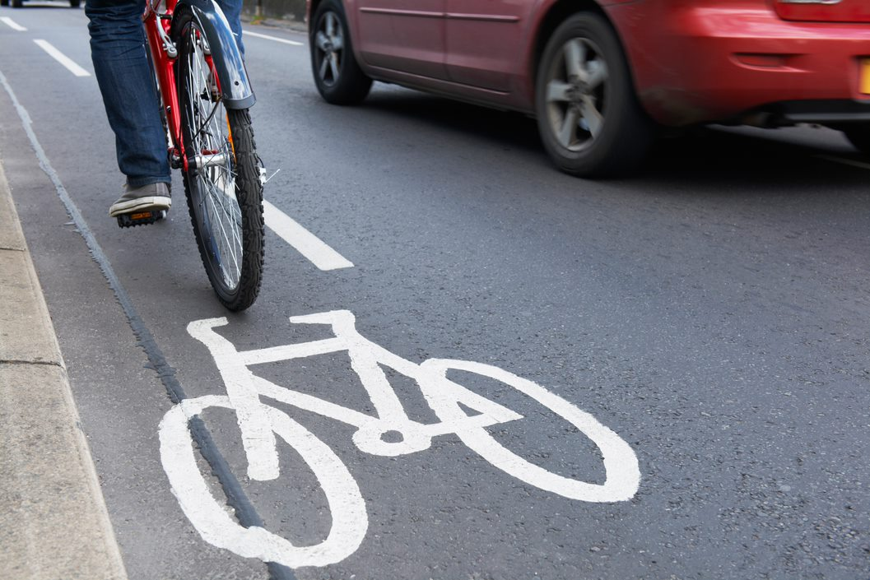
^{PROACTIVE}
TRAFFIC SAFETY – What You Need to Know
Growing proactive traffic safety is an opportunity for traffic safety professionals and stakeholders to create lasting and sustainable improvements in traffic safety behaviors.
Notes:
There is a strong research foundation for proactive traffic safety. Growing proactive traffic safety is an opportunity for traffic safety professionals and stakeholders to create lasting and sustainable improvements in traffic safety.

Slide 14
^{PROACTIVE}
TRAFFIC SAFETY – Where We Go from Here
Proactive traffic safety is a new opportunity to improve traffic safety.
It’s an approach that leverages our existing positive traffic safety culture and, once established, is likely to be sustained.
Action is needed to move this approach forward.
    ^{Tools}
    ^{Tips}
    ^{Reflection Questions}
Notes:
Traffic safety professionals and stakeholders have significantly improved traffic safety in the United States. Education, enforcement, and engineering have been essential to this success. However, in pursuit of our Towards Zero Deaths goals, new approaches may be required.
Proactive traffic safety is a new opportunity to improve traffic safety. It’s an approach that leverages our existing positive traffic safety culture and, once established, is likely to be sustained.
Action is needed to move this approach forward. Tools, tips, and reflection questions can help get you started.

Slide 15
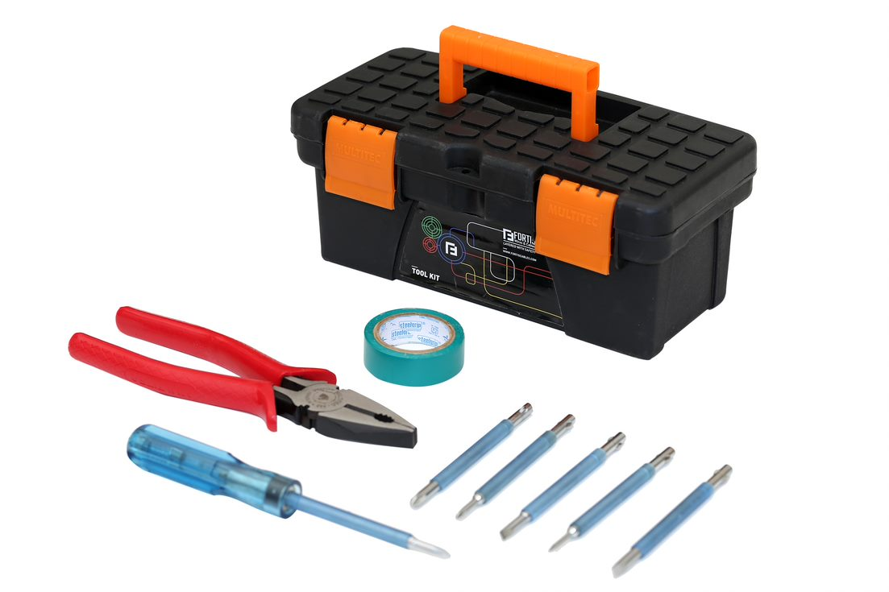
^{PROACTIVE}
TRAFFIC SAFETY – Where We Go from Here
^{Tools}
A Proactive Traffic Safety Primer
A Proactive Traffic Safety PowerPoint Presentation
^{A Conversation Guide}
A Proactive Traffic Safety Poster
Notes:
To help you engage others about proactive traffic safety, a variety of communication tools have been developed.
There is a Proactive Traffic Safety Primer that provides a strong foundation for what proactive traffic safety is, where it originated, and what it looks like in action.
There is this Proactive Traffic Safety PowerPoint Presentation that you can use to introduce proactive traffic safety to others
A Conversation Guide has been created to support your efforts to engage others about proactive traffic safety, and
a Proactive Traffic Safety Poster has been developed to be used in meetings and at conferences.

Slide 16
^{PROACTIVE}
TRAFFIC SAFETY – Where We Go from Here
^{Tips}
Tip #1. Think in Terms of Allies and Partners
Tip #2. Engage Others about Proactive Traffic Safety
Tip #3. Grow a Shared Understanding of Proactive Traffic Safety
Tip #4. Think about Hosting a Meeting, Providing a Presentation,
and/or Facilitating a Conversation about Proactive Traffic
^{Safety}
Tip #5. Use the Available Communication Tools
Tip #6. Integrate Proactive Traffic Safety into Existing Strategic
^{Highway Safety Plans}
Notes:
There are many ways to help traffic safety professionals grow proactive traffic safety. Some tips include:
Tip #1. Think in Terms of Allies and Partners. Growing proactive traffic safety requires both allies and partners. Allies are those that can champion your effort and connect you to other social networks and connections that are needed to grow proactive traffic safety. Consider: Who are my allies in promoting traffic safety? Who can help me introduce a new idea to other key stakeholders?
Partners are those that will participate and help you to move proactive traffic safety forward. Partners are those that will take action. Start to identify partners by considering who is within your circle of influence. Identify the people you have a relationship with, can easily collaborate with, and with whom you can directly influence. Partnering with those within your circle of influence first can build momentum. Growing proactive traffic safety can begin at the grass roots level and doesn’t require high-level leadership to buy-in initially.
Consider: Who can I partner with? Who has a direct stake in growing proactive traffic safety?
In this process, it is important to think outside of your normal partners. Explore potential new partnerships within a variety of disciplines (i.e. public health professionals, healthcare professionals, prevention specialists, etc.).
Tip #2. Engage Others about Proactive Traffic Safety. Start talking about proactive traffic safety. Talking with others about proactive traffic safety:
•creates shared understanding about what proactive traffic safety is
•fosters meaningful dialogue about how proactive traffic safety can improve existing efforts
•encourages collaboration, and
•mobilizes buy-in and support.
When others hear you talking about proactive traffic safety, see your excitement, and see how proactive traffic safety can improve health and safety, they will be more willing to engage with you.
Tip #3. Grow a Shared Understand of Proactive Traffic Safety. Growing proactive traffic safety requires a clear understanding of what proactive traffic safety is. Seek to grow shared understanding and common language about proactive traffic safety by engaging with other traffic safety professionals, coworkers, leaders, and stakeholders.
Establishing a shared understanding about proactive traffic safety can foster engagement and align efforts to grow proactive traffic safety within existing strategies moving forward.
Tip #4. Think about Hosting a Meeting, Providing a Presentation, and/or Facilitating a Conversation about Proactive Traffic Safety. A meeting or presentation can help familiarize stakeholders with the concept of proactive traffic safety. You can bolster excitement and facilitate a constructive conversation with important stakeholders and partners.
Tip #5. Use the Available Communication Tools. Communication tools have been created to accompany this Primer to help grow proactive traffic safety with coworkers, leaders, and stakeholders. These tools include: A Proactive Traffic Safety Primer, Proactive Traffic Safety PowerPoint Presentation, Conversation Guide, and Proactive Traffic Safety Poster
Tip #6. Integrate Proactive Traffic Safety into Existing Strategic Highway Safety Plans
Depending on your state’s process, how you integrate proactive traffic safety into your Strategic Highway Safety Plan might look differently. Here are some ideas:
• You could add a chapter on proactive traffic safety into your Strategic Highway Safety Plan. Develop principles of communication with proactive traffic safety in mind and add communication guidance as part of the plan.
• You could identify strategies within the Strategic Highway Safety Plan that address high-risk behaviors and consider augmenting these strategies with proactive traffic safety. While it can be tempting to select several high-risk behaviors, start small and build momentum

Slide 17
^{PROACTIVE}
TRAFFIC SAFETY – Where We Go from Here
^{Reflection questions}
How could growing proactive traffic safety help you achieve your desired traffic safety outcomes?
What are the opportunities for applying proactive traffic safety to your current efforts right now?
Notes:
As you start to talk about proactive traffic safety with others, it is important to have thought through this concept in your own work. Your excitement about proactive traffic safety will get others excited too.
Think about: How could growing proactive traffic safety help you achieve your desired traffic safety outcomes? What are the opportunities for applying proactive traffic safety to your current efforts right now?

Slide 18
^{PROACTIVE}
^{TRAFFIC SAFETY}
^{Conclusion}
Traffic safety professionals and stakeholders must continue to evolve and seek innovative ways to reduce risky driver behaviors and increase safer behaviors.
Growing proactive traffic safety cultivates a traffic safety culture where people commit to a safer transportation system.
Growing proactive traffic safety behaviors is a new opportunity to strategically address risky traffic behaviors and ultimately achieve and sustain our Towards Zero Deaths goals.
Notes:
Given the only acceptable traffic safety goal is to reduce fatalities and serious injuries to zero, traffic safety professionals and stakeholders must continue to evolve and seek innovative ways to reduce risky driver behaviors and increase safer behaviors.
Growing proactive traffic safety cultivates a traffic safety culture where people commit to a safer transportation system.
Growing these proactive behaviors is a new opportunity to strategically address risky traffic behaviors and ultimately achieve and sustain our Towards Zero Deaths goals.

Slide 19


^{PROACTIVE}
^{TRAFFIC SAFETY}
^{Research Sponsor}
Traffic Safety Culture Pooled Fund
The transportation Pooled Fund (TPF) Program allows federal, state, and local agencies and other organizations to combine resources to support transportation research studies.
Current participating States: CA, CT, ID, IL, IN, IA, LA, MS, MT, NV, TX, UT, VT, and WA.
Managed by: Sue Sillick, Research Programs Manager
Montana Department of Transportation
2701 Prospect Avenue, PO Box 201001
^{Helena, MT 59620-1001}
^{Office: 406.444.7693}
E-mail: ssillick@mt.gov www.mdt.mt.gov/research/

Slide 20

^{PROACTIVE}
^{TRAFFIC SAFETY}
^{Contact us}
^{Email: mail@chsculture.org}
^{Phone: (406) 994-7873}
#CHSCulture
www.chsculture.org

